Slide 1
Registered Apprenticeship Programs for Businesses

Slide 2
AGENDA
Brief Overview of Apprenticeships
Benefits of apprenticeships
Partnering to customize an apprenticeship for you

Slide 3
WHY APPRENTICESHIPS?
Apprenticeship is an industry-driven, high-quality career pathway
Employers can develop and prepare their future workforce
Individuals can obtain paid work experience, classroom instruction, and nationally-recognized credentials for highly skilled occupations
Apprenticeship is a proven solution to create and retain your talent pipeline

Slide 4
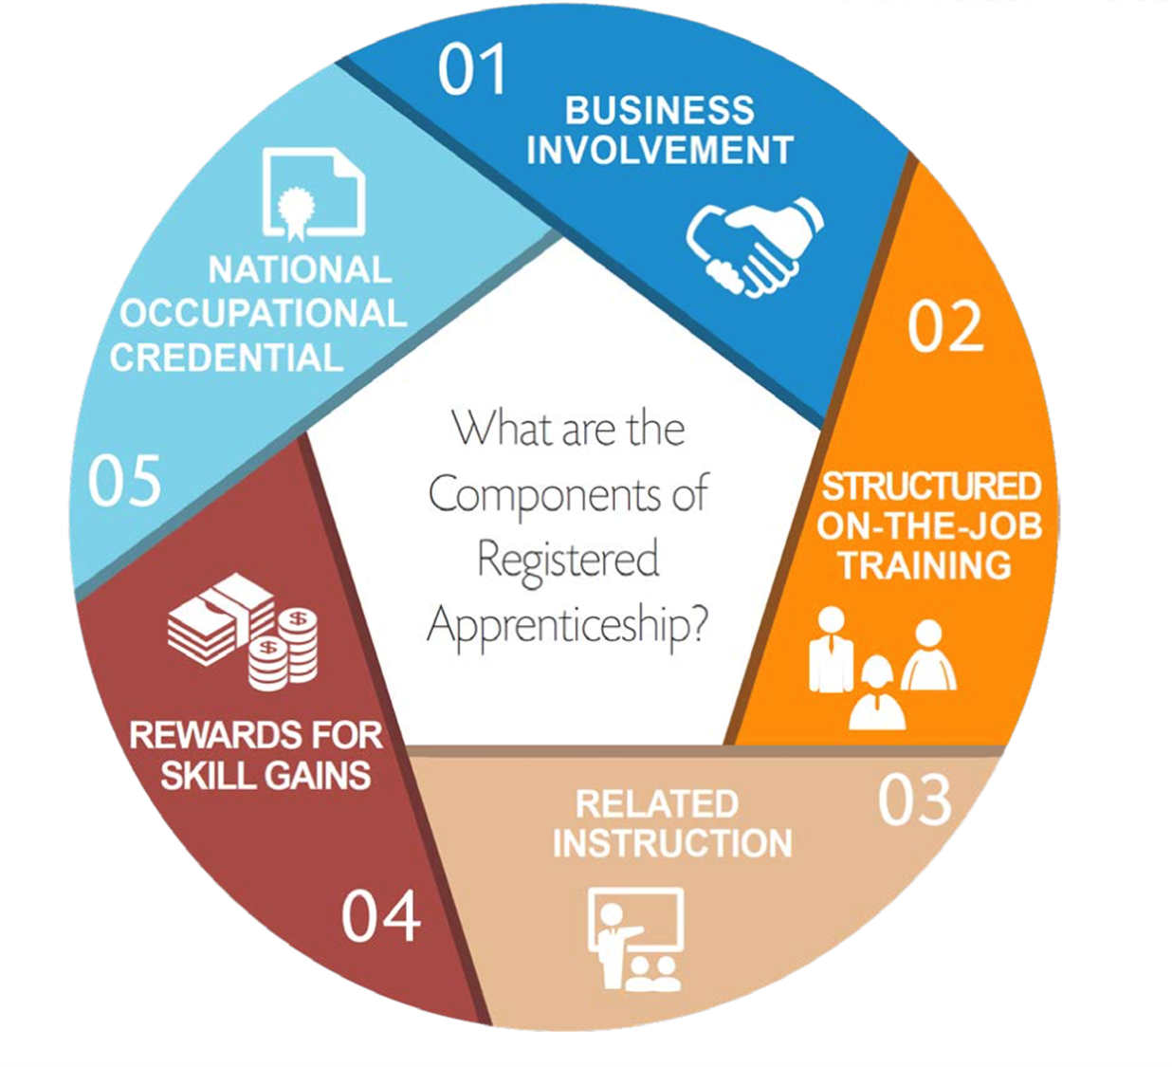
The Five Components of ApprenticeshipPrograms for Businesses

Slide 5
EXAMPLES OF APPRENTICEABLE OCCUPATIONS
Over 230 traditional and NON-TRADITIONAL occupations:
Cloud and Data Center Support Technicians
Cyber Security Professionals
Environmental Care Supervisors
Health Unit Coordinator
IT Project and Business Analysts
Software Development Analysts
Telecommunication Tower Technicians
You are not limited to the existing occupations. You can create new ones!

Slide 6
BENEFITS TO BUSINESSES
Apprenticeship programs allow business owners to:
Build your workforce and a talent development solution
Customize the right training model for your company
Reduce turnover, improve loyalty, and increase retention
Plan for employee succession
Attract women, minorities, and veterans
Increase productivity and improve community relations
Apprenticeships are good for employers and career seekers.

Slide 7
MOST IMPORTANTLY…. Local, State and Federal Tax Incentives
Work Opportunity Tax Credit
Enterprise Zone Tax Credit
MD Disability Employment Tax Credit
Hire Our Veterans Tax Credit
Sales and Use Tax Credit
Link http://www.dllr.maryland.gov/employment/taxcreditintroduction.shtml
Work Opportunity Tax Credit & State Tax Credits

Slide 8
OPTIONS FOR FINANCIAL INCENTIVES FOR BUSINESS OWNERS
Employers may receive 50% reimbursement upon the completion of the completion of the school year,
Employers may receive $3,000 per newly registered apprentice
Employers may be reimbursed up to $4.680 for small firm and $3.120 for larger firms for the cost of the apprentice’s first 6 months

Slide 9
HOW WE CAN PARTNER WITH YOU
Help
Exploring and understanding the process and provide an alternate approach to develop the talent pipeline
Support
When creating new programs, and help designing and registering your program
Connect
Outreach and use various outlets to list your open positions & make sure the right job seekers find your apprenticeship
With apprenticeship experts and customize the right model for your business
Promote

Slide 10
CREDENTIALS
Upon program completion apprentices earn a portable, nationally recognized credential within an industry.
The program is intensive, rigorous, and competency-based.

Slide 11
Who is your contact? Dolly Bermudez Apprenticeship Coordinator Howard County Office of Workforce Development dbermudez@howardcountymd.gov 410 290 2648 See Flyers in English & Spanish
To register in upcoming Apprenticeship sessions and Workshops: https://form.jotform.com/220376157882159
Website: https://www.howardcountymd.gov/howardworkforce

